Slide 1


Algorithm Efficiency Search, Sort, and Big-O notation
CS 1181 – Computer Science II
Dr. Michael Raymer
Lecture materials adapted from:
ZyBooks ISBN: 979-8-203-16123-9 Dr. Cay Horstmann, Univ. of Michigan Dr. Roman Lysecky, Univ. of Arizona
Dr. Adrian Lizarraga, Univ. of Arizona
Dr. Travis Doom
Dr. Michelle Cheatham
Unless otherwise noted images are used under the creative commons license or used under license from Adobe Stock.

Slide 2
What makes a program “good”?
Bug-free, well-tested
Secure
Fast
Doesn’t hog memory
Algorithm Efficiency

Slide 3
Problems and Algorithms
Algorithm: An approach to solving a computational problem
Problem: A mapping from input → output

Slide 4
Computational Problems
Sort
Input: A list of numbers
Output: The input list, sorted from smallest to largest
Traveling Salesman
Input: A list of cities, a matrix of distances from each city to each other city, and a start city
Output: The shortest path that visits each city exactly once and return to the start city
Notes:
Max, min, factor, prime?, search, bin-packing, subset-sum, etc.

Slide 5
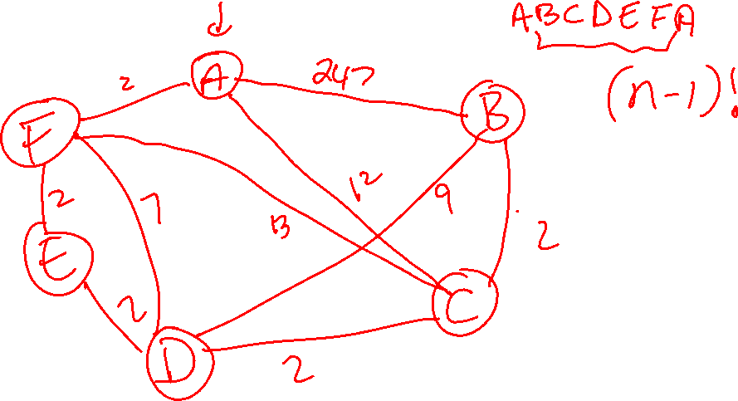

Slide 6
Algorithms
An algorithm is a series of computation steps (instructions) that (always) solves a computational problem.
An algorithm must be…
Finite – It must terminate, eventually
Correct – It must solve the problem every time
Deterministic – Made of concrete, computer-executable steps and produce the same output every time (with the same input)

Slide 7
One problem, many algorithms
Problem: Sort(list-of-integers)
“Algorithm” 1:
Find the smallest value, swap it with the first
Find the next smallest, swap with the second
Etc…
“Algorithm” 2:
Randomly shuffle the numbers
Check if sorted, repeat if necessary

Slide 8
Which algorithm is best?
Fast – Computational complexity
Doesn’t hog memory – Space complexity

Slide 9


Fast is not a number!
27 | 2 | 34 | 67 | 113 | 142 | 192 | 207 | 351 | 429
My sort algorithm takes 27 seconds to run.
My sort algorithm takes 12 seconds to run.

Slide 10

Fast is a function
Algorithm 2
Algorithm 1
Time
Size of input

Slide 11


How fast is my algorithm?
My sort algorithm takes 27 seconds to run.
My sort algorithm takes 12 seconds to run.

Slide 12
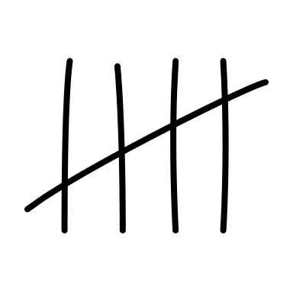
Fast is a function
Algorithm 2
Algorithm 1
Number of instructions executed
Size of input

Slide 13

Counting Instructions
public static boolean search(int[] values, int target){
for (int i = 0; i < values.length; i++){
if (values[i] == target){
return true;
}
}
return false;
}
values:
27 | 2 | 34 | 67 | 113 | 142 | 192 | 207 | 351 | 429
target: 77

Slide 14


Counting Instructions
Some “instructions” take more time than others!
ILOAD 1
ILOAD 2
IADD
ISTORE 3
k = i + j;

Slide 15
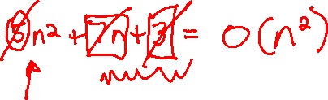
Big-O notation
What we need is a more precise and rigorous way to say: This algorithm takes, about n² instruction executions to sort n numbers in the worst case.
$$T_{my_sort}\left(n\right)=O\left(n^{2}\right)$$

Slide 16
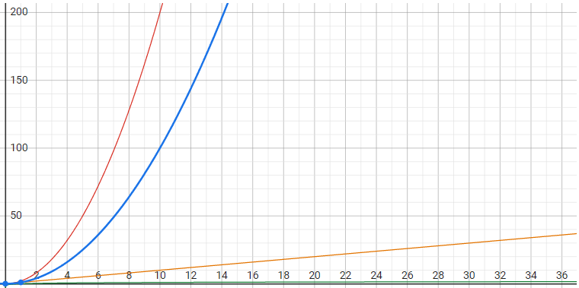
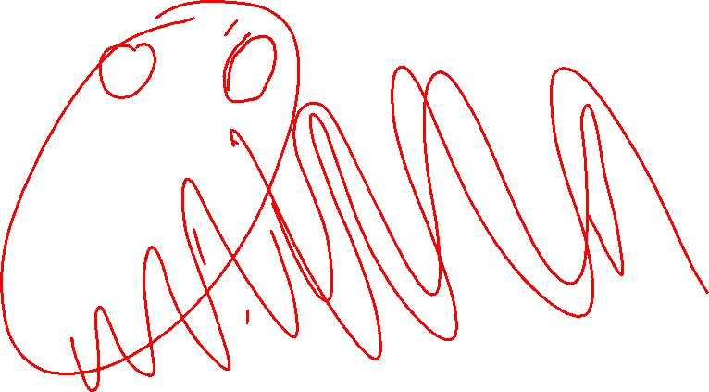
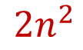
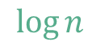
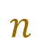
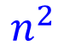
O(n²)
$$2n^{2}$$
$$n^{2}$$
$$n$$
$$\log{n}$$

Slide 17
What Big-O lets us do
$$T_{my_sort}\left(n\right)=7n^{2}+5^{n}+3$$
Drop all but the highest-order term
$$T_{my_sort}\left(n\right)=O\left(7n^{2}\right)$$
Drop all constant coefficients
$$T_{my_sort}\left(n\right)=O\left(n^{2}\right)$$

Slide 18

Linear Search
Input
list: an unsorted array of integers
target: value to search for
Output
True, if target is present in the list
False otherwise
values:
27 | 49 | 18 | 52 | 113 | 142 | 63 | 207 | 142 | 88
target: 77

Slide 19
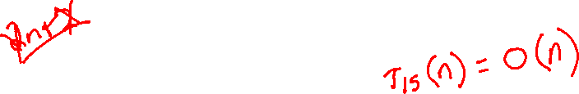
Linear Search
public static boolean search(int[] values, int target){
for (int i = 0; i < values.length; i++){
if (values[i] == target){
return true;
}
}
return false;
}
values:
27 | 49 | 18 | 52 | 113 | 142 | 63 | 207 | 142 | 88
target: 77
What is the best-case time complexity? How about the worst?

Slide 20
Binary Search
Suppose the list is sorted, can we do better?
target: 77
values:
2 | 27 | 34 | 67 | 113 | 142 | 192 | 207 | 351 | 429

Slide 21


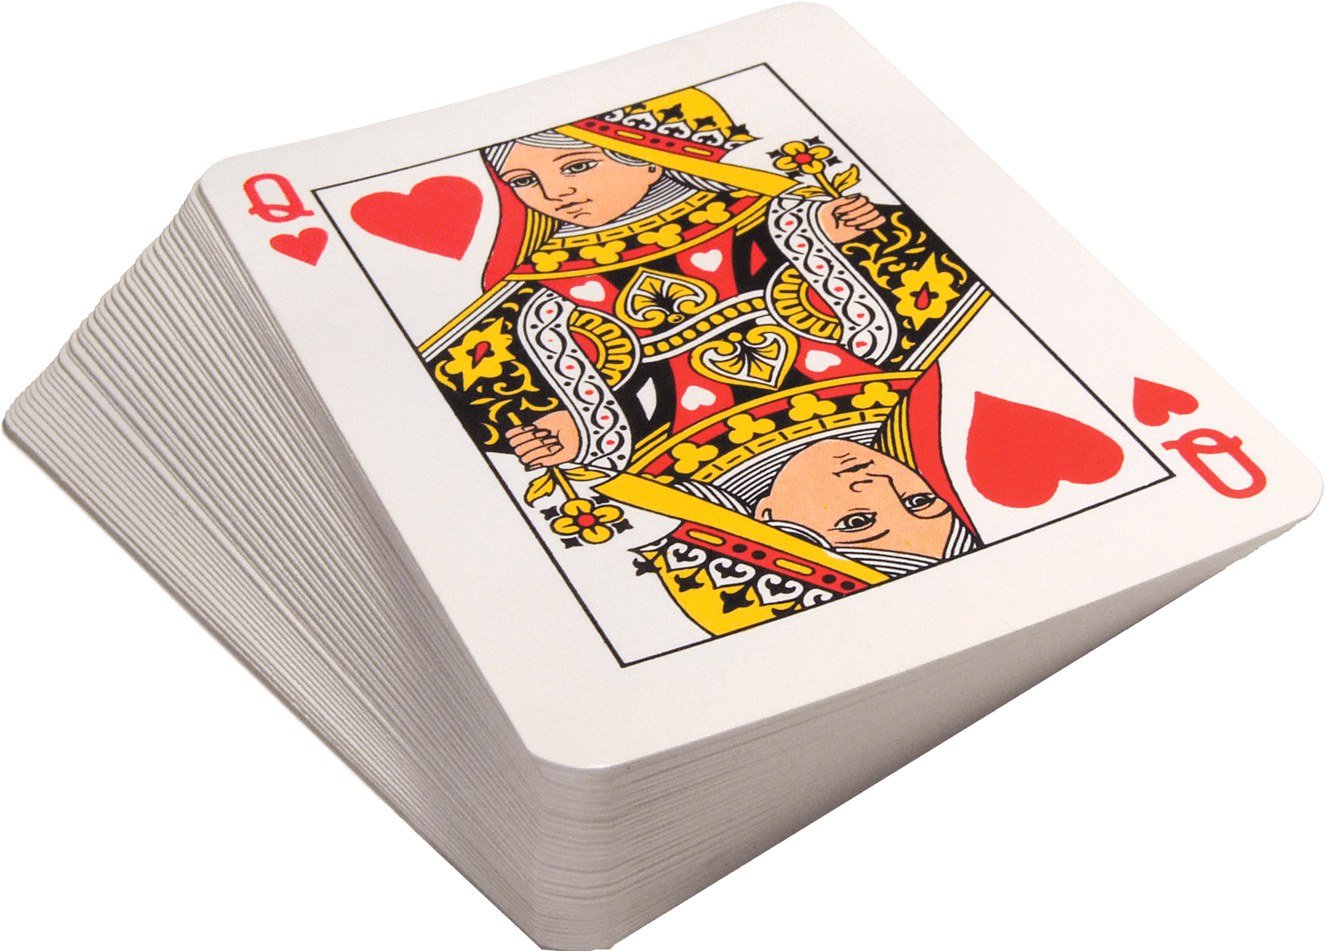

Sorting
Sort
Input: A list of numbers
Output: The input list, sorted from smallest to largest
Algorithms
Bubblesort
InsertionSort
SelectionSort
MergeSort
QuickSort
A K Q J 10 9 8 7 6 5 4 3 2
Notes:
Max, min, factor, prime?, search, bin-packing, subset-sum, etc.

Slide 22
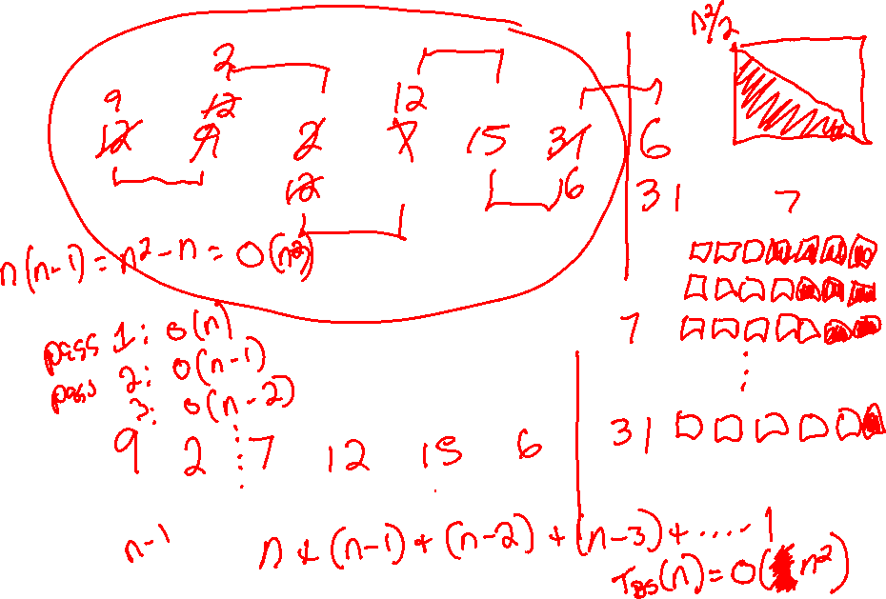

Slide 23

Test your understanding
True or false?
5n² + 2n + 3 = O(n²)
n²/3 = O(n²)
2n + 5 = O(n²)
n³ – 3n² = O(n²)
n³ – 3n² = O(2^{n})
3^{n} = O(2^{n})

Slide 24

SelectionSort
2
5
11
17
34
14
21
18
15
Sorted

Slide 25









InsertionSort
5
11
14
17
18
34
21
2
15
Sorted
1 + 2 + 3 + 4 + 5 + … + (n-1)

